Slide 2
A workshop in applied bioinformatics
Mikael Lenz Strube
milst@dtu.dk

Slide 3

Me
Associate Professor at DTU Bioengineering
Biochemical engineer turned bioinformatician
Research focused on microbiomes and how they communicate
Currently work at the Center of Secondary Metabolites (CeMiSt; https://cemist.dtu.dk/)
This will only be fun if you talk to me - if you dont follow the material, then tell me!

Slide 4
This will only be fun if you talk to me!

Slide 5
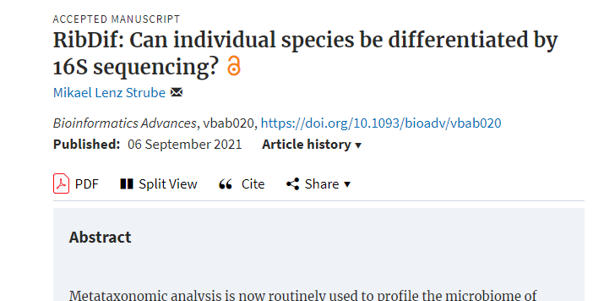
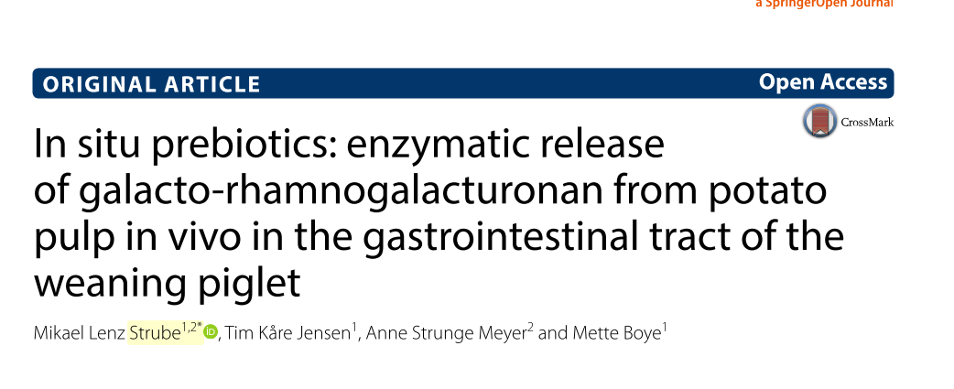
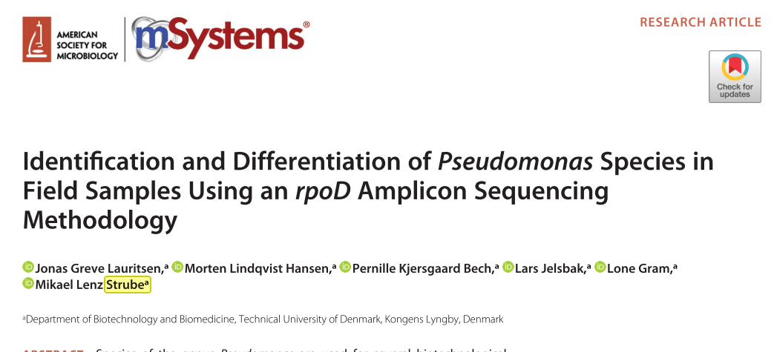
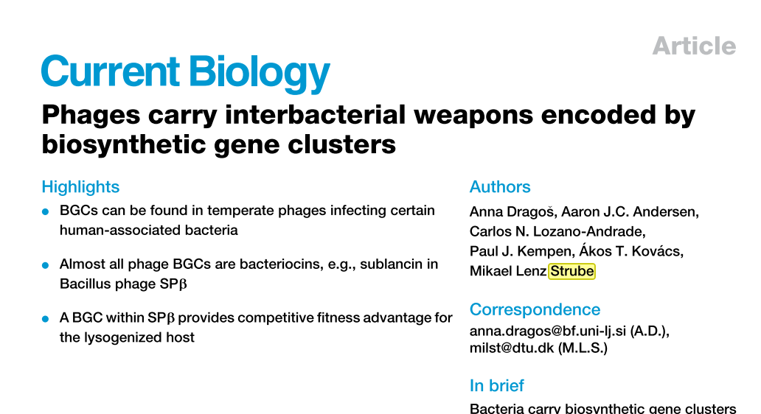




Slide 6
What will you learn here?
The command line
How to handle environments
How to download big data
How to analyze and compare genomes
How to analyze complex microbiomes
How to assemble (meta)genomes

Slide 7
What will you be frustrated about?
The logic of the command line
You learn how to speak Danish by speaking Danish
Installing software
90% of the workload for a bioinformatician
Things are probably outdated when I give this talk
Many of you will fail here, so work together
Running software
Your stylish laptop might not be made for this

Slide 8
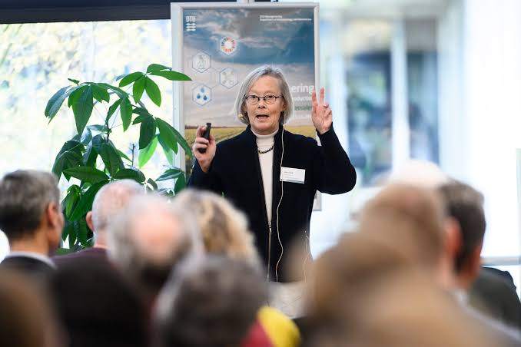
WHY?

Slide 9
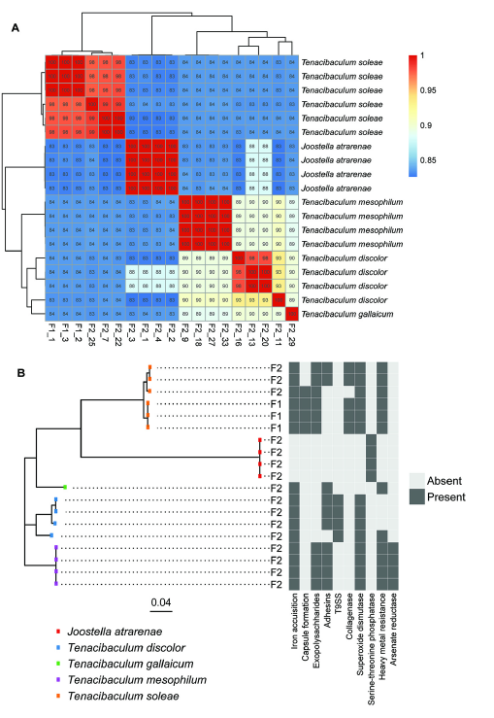
The gene content of pathogenic marine bacteria depends on their phylogeny
Tesdorpf, Jens Edward, Aileen Ute Geers, Mikael Lenz Strube, Lone Gram, and Mikkel Bentzon-Tilia. 2022. “Roseobacter Group Probiotics Exhibit Differential Killing of Fish Pathogenic Tenacibaculum Species.” Applied and Environmental Microbiology.

Slide 10
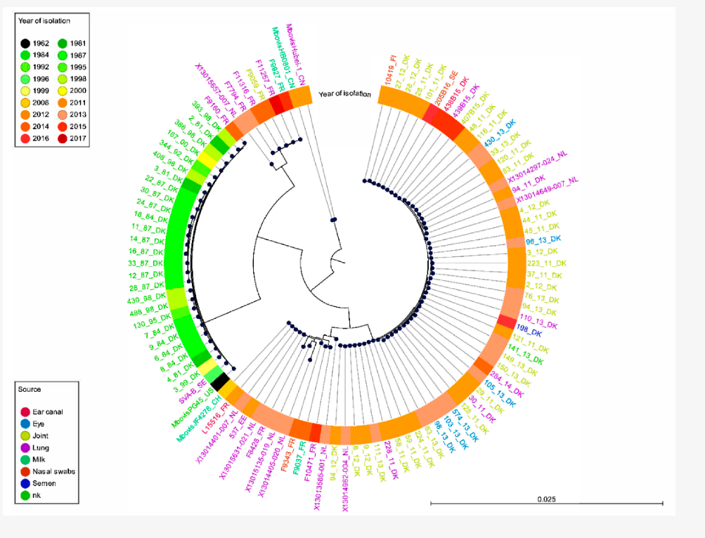
The Mycoplasma infecting european cows arrived around 2010 and is highly reduced in genomic size
Tardy, Florence, Anna Aspan, Tiina Autio, Anne Ridley, Agnès Tricot, Adélie Colin, Tarja Pohjanvirta, et al. 2020. “Mycoplasma Bovis in Nordic European Countries: Emergence and Dominance of a New Clone.” Pathogens 9 (11): 1–15.

Slide 11
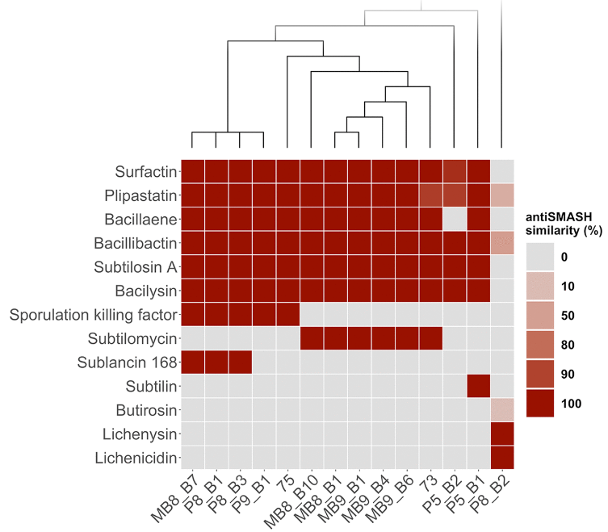
Bacillus species are highly diverse in their capacity for secondary metabolite production
Kiesewalter, Heiko T., Carlos N. Lozano-Andrade, Mario Wibowo, Mikael L. Strube, Gergely Maróti, Dan Snyder, Tue Sparholt Jørgensen, et al. 2021. “Genomic and Chemical Diversity of Bacillus Subtilis Secondary Metabolites against Plant Pathogenic Fungi.” MSystems 6 (e00770-20): 1–15.

Slide 12
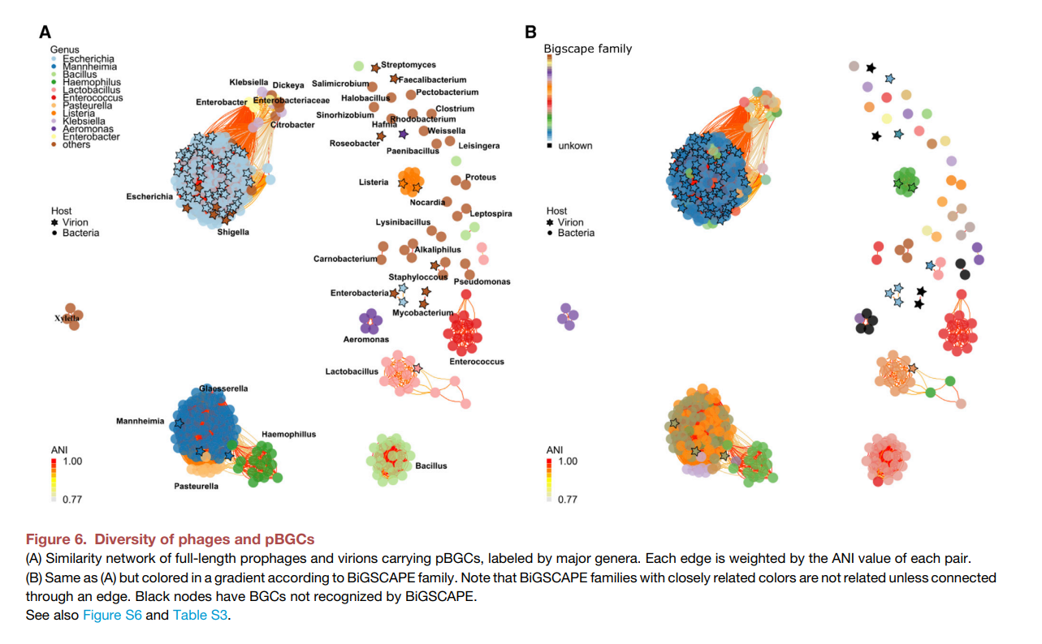
Phages carry secondary metabolites which their hosts can use
Dragoš, Anna, Aaron J.C. Andersen, Carlos N. Lozano-Andrade, Paul J. Kempen, Ákos T. Kovács, and Mikael Lenz Strube. 2021. “Phages Carry Interbacterial Weapons Encoded by Biosynthetic Gene Clusters.” Current Biology 31: 1–11.

Slide 13
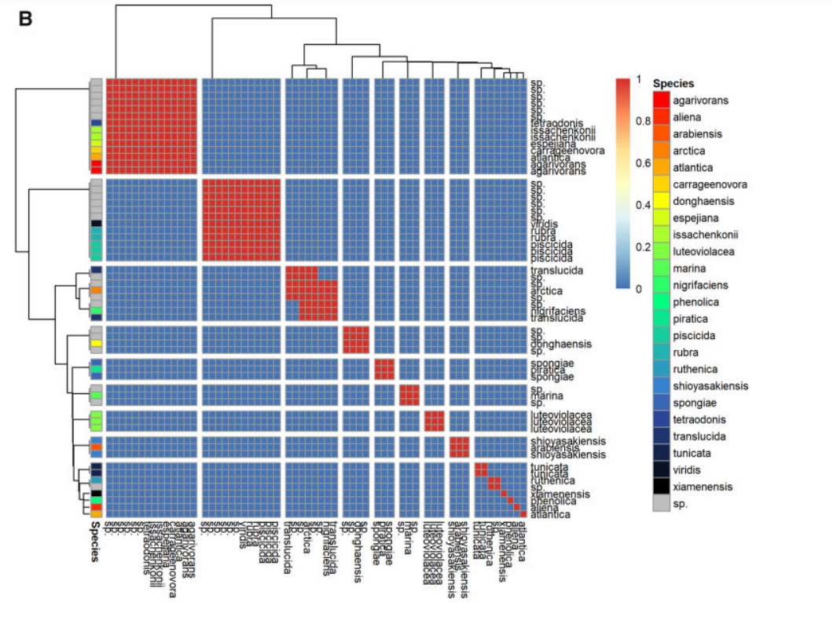
16S sequencing cannot seperate most bacterial species
Strube, Mikael Lenz. 2021. “RibDif: Can Individual Species Be Differentiated by 16S Sequencing?” Bioinformatics Advances 1 (1): 1–5.

Slide 14
The command line
Does everyone have their linux install ready?
Does everyone have their conda install ready?
If you dont, you will not make it very far here
10 min break to get everyone set up
copy is done by ctrl+shift+c and paste is by right clicking
unless set up differentially in the ubuntu menu
If things go crazy, you can stop a process with ctrl+c

Slide 15
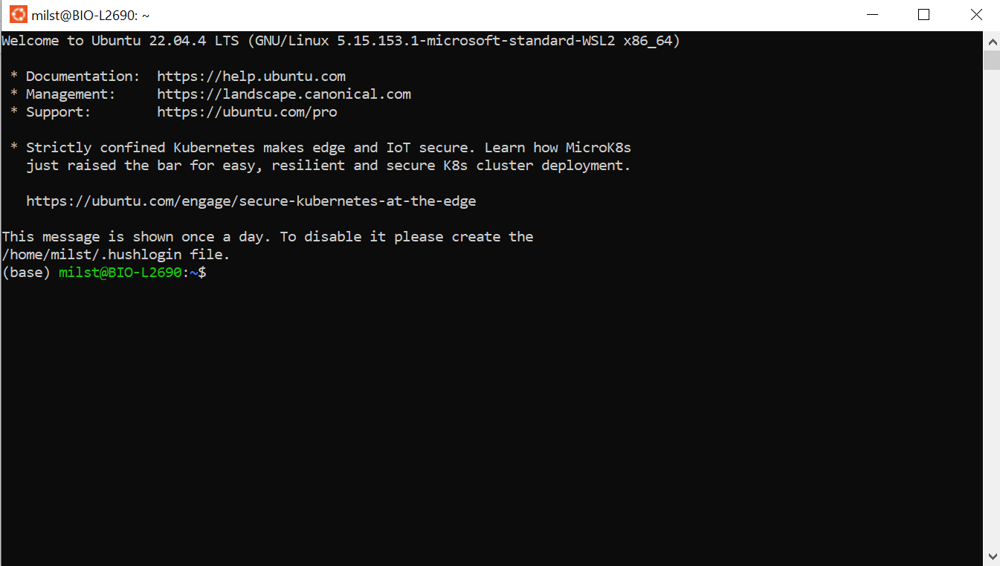
Bash interactive session

Slide 16
Bash interactive session
Ubuntu is a modern and popular version of the fairly old Linux operation system
Mac runs on top of a seperate Linux distribution
What is the structure of Linux and the conda system?
Open up the windows/Mac GUI view of your command line position
‘explorer.exe .’
‘Finder .’ ?
‘open pwd’ ?
Your C-drive is in:
/mnt/c/Users/milst/
cd /mnt/c/Users/milst/

Slide 17
Where are your things?
Where do you download to?
Where is your desktop?
Break until everybody know the answers to both!

Slide 18
Command line and arguments
A flag without an argument,
often interpreted as a yes/no
The argument to -A
The basic syntax:
PROGRAM -A SOMEVALUE --AFULLFLAG SOMEOTHERVALUE -C
A ‘flag’ that expects an arguments
The argument to --AFULLFLAG
The program
Another way to specify a ‘flag’, note the double dash for full words
rather than the single letter before
https://github.com/mikaells/RibDif
RibDif.sh --genus Lactobacillus --primers /home/milst/RibDif/default.primers --clobber --ANI --frag --msa --id 1 --threads 10
RibDif.sh -g Lactobacillus -p /home/milst/RibDif/default.primers -c -a -f -m -i 1 -t 10

Slide 19
Working with directories
Have a look (ls = ‘list things’)
ls
ls -l -a #list files with details (-l) and also hidden things (-a)
Make a folder (mkdir = ‘make directory’
mkdir XXXXX
Go to folder (cd = ‘change directory’)
cd XXXX
Go to the previous folder
cd ..
Make a folder in the folder you just made (note that we are all the way back)
mkdir XXXX/YYYY
Make a file in that folder (touch = create some file)
touch XXXX/YYYY/ZZZZ.txt
Write something in it (echo = put text in the terminal; ”>” = redirect stuff from the terminal to somewhere)
echo ”Hello World” > XXXX/YYYY/ZZZZ.txt
Dont call it that, pick something you like - your choice

Slide 20
Working with files
Look at a everything in a file (cat = technically made for ‘concatenating multiple files, but good for viewing)
cat .bashrc
look at some of a file
head .bashrc #by default 10 lines
head .bashrc –n 5 #only five lines
tail .bashrc #same as head, but from the bottom
Put the 15-20 lines of a file into a new one with the ‘|’ (pipe) operator:
head .bashrc –n 20 | tail –n 5 > dummy.txt
cat dummy.txt #have a look
rm dummy txt #delete it again

Slide 21
What is (ana)conda?
Anaconda is the original wordplay on a python environment
An environment is a ‘setting’ for your current ‘session’
Your session is what you do today or for a given project
Your setting is the programs available for your session
Your setting specifies what programs and folders you can work with
Your session is then what you can do with a particular setting
Sounds complicated (and is)
But imagine this:

Slide 22
Your system
Program A V1.0
Fine alone
An environment
An environment
Program A V1.5
Program A V1.3
Depends on
?
Depends on
Program B V1.0
Program B V1.1

Slide 23
Your system
Program A V1.0
Fine alone
Program A V1.5
Program A V1.3
Depends on
Depends on
Program B V1.0
Program B V1.1

Slide 24
Loops
we use ‘i’ (the ‘iterator’) to keep track of where we are in the loop
We loop across 1-10, e.g. 1,2,3, etc
for i in {1..10}; do
echo $i
done
in bash terminology, we declare ‘i’ just as ‘i’, but when we call it, we use $i
for i in {1..10}; do echo $i; done
same as before, easier to copy and paste

Slide 25
The ‘find’ command
Searches for things
can understand the wildcard character = *
* in bash means anything and no matter how long
in other languages and regular expressions, it means something unlimited times:
.* # the dot is here everything and * means any amount of times
^GCF_[0-9]* # must start with GCF and then any length of only numbers
basic syntax is
find SOMEWHERE -name ”SOMEPATTERN”
#confusingly, the name argument only has one dash
find miniconda3/ -name "*txt"
#will look in the folder miniconda3 for any files with a name that ends with txt
this will spit out a lot of files, good time to practice the way to stop commands?
Your current folder is ./

Slide 26
Combining things
You can combine commands a lot, like using the find function in a loop like this
for i in $(FINDCOMMAND); do
SOMETHINGWITH $i;
done
See if you can understand the following loop and then you should be good to go
for i in $(find miniconda3/ -name "*txt" | head ); do echo $i; head $i; done
only takes the first 10 values of
the find command
print the current name of the variable
Print the first 10 lines of the file the variable refers to
find command, finds anything
ending in ‘txt’ in the folder miniconda3
A pipe

Slide 27
Very important!
Read the exercises and the powerpoints!
Ask the teachers as much as posible!
ASK MIKAEL AS MUCH AS POSIBLE!
Some things might just not work
A lot of things wont work

Slide 28
Keep in mind
Everything is installed with conda, no exceptions unless I specifically state it
No pip, no apt and especially no sudo!
You can autocomplete commands with TAB – hugely useful for filenames!
You can stop a process gone crazy with Ctrl+C
You can copy from the command line with Ctrl+C and paste with right-click
You can go to the start of a command with Ctrl+A
You cannot ruin anything on your computer with this setup – executing a command is better than staring at it!
Watch out for ChatGPT!
How are you keeping track of your code?

